Slide 1
Prediction of H1B Visa Petitions Decision
CS-513 Knowledge Dis & Data Mining
——Instructor: Prof. Khasha Dehnad

Slide 2

Team Pictures
Sumit Gupta
10441745
Fall 18 MSCS

Slide 3
PRESENTATION
AGENDA
1
Introduction
2
About the Data
3
Work To Be Done
4
Data Visualization
5
Implementation of Model

Slide 4

Introduction
The H1B visa is a temporary or non-immigrant “specialty occupation” US visa, which means the holder is employed in a position that requires specialized skills or knowledge.
A certified Labor Condition Application (ETA Form 9035), is a prerequisite to H1B approval. The LCA must be certified by the Department of Labor (DOL) before the H1B petition is submitted to USCIS.
The Labor Condition Application (LCA) contains basic wage and location information about the proposed H1B employment. The LCA contains the rate of pay, period of employment, and work location.

Slide 5

Continued….
IMPORTANT The LCA must be CERTIFIED by the DOL and submitted with the Form I-129 for the H1B petition to be approved by USCIS.

Slide 6
Problem Statement:
“To predict whether a person’s LCA application will be CERTIFIED or DENIED based on his profile.”
Proposed Solution:
“I propose to solve this problem using classification techniques in data mining.”

Slide 7
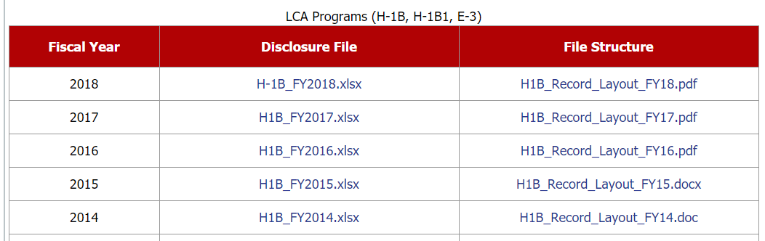
About the DATA
Office of Foreign Labor Certification (OFLC) generates program data that is essential both for internal assessment of program effectiveness and for providing the Department’s external stakeholders with useful information about the immigration programs administered by OFLC.
In line with the Department’s commitment to the Open Government initiative and specific regulatory disclosure requirements, OFLC makes public the annual releases of program disclosure data to assist with external research and program evaluation.
Raw data is available at https://www.foreignlaborcert.doleta.gov/performancedata.cfm

Slide 8
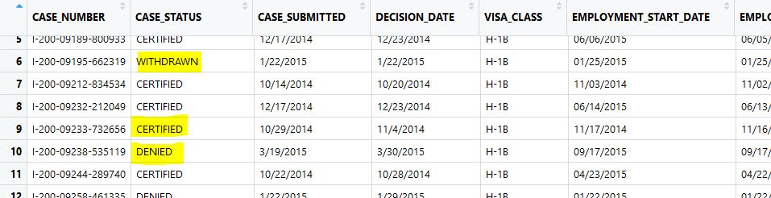
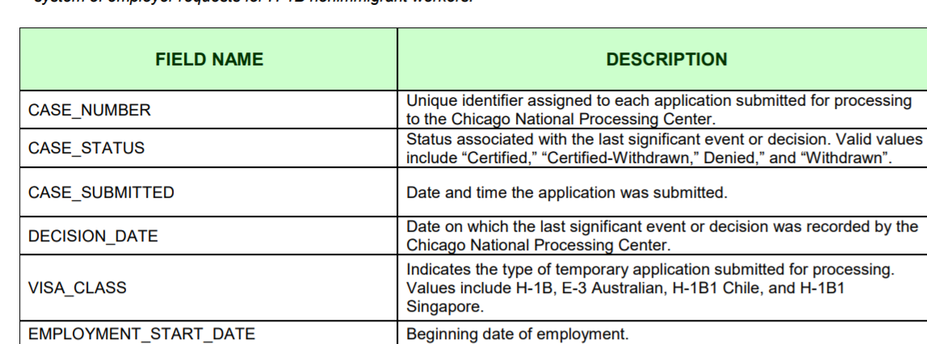
Data Screenshot

Slide 9
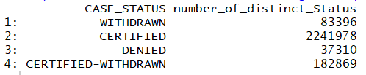
Data Insight
Source: public disclosure file Employment and Training Administration Office of Foreign Labor Certification
I have downloaded the data of year 2015, 2016,2017 and 2018 for analysis and applying my model.
Raw data consist of approx. 3 million rows.
The target variable in our dataset is CASE_STATUS.
Raw data:

Slide 10
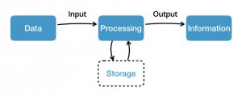
Data Processing
I created FIN_YEAR variable and assign it a value 2015, 2016, 2017 or 2018 based on the financial year a decision is made on the case by the authorities for all the 4 files
FY-2015 H1-B filing data has 41 columns
FY-2016 H1-B filing data has 41 columns
FY-2017 H1-B filing data has 53 columns
FY-2018 H1-B filing data has 53 columns
Before we start cleaning the data, we need to merge the data frame to form one huge file that will be used for cleaning and implementing Prediction model. After merging all the 4 data frames we found that there are 31 matching columns in each of the data frames..

Slide 11
Data Cleaning
Records are filtered out to retain only those records corresponding to H-1B visa_class.
The merged dataset we have has only 10 variables that are of interest for our analysis and drop else.
8 column are directly taken from the data, 2 are derived feature
We want to know if an employee is a full time or a part time worker
We do the scaling of the hourly, Weekly, Bi-Weekly and monthly salaries to a yearly pay
Remove the row with empty cell
Records with extreme PREVAILING_WAGE values are discarded. (RANGE IS 25K TO 200K)
Filtering the data based on 8 most common Occupations i.e.
Engineering
Management
Executive
Teacher
Technician
Accountant
Developer
Software

Slide 12
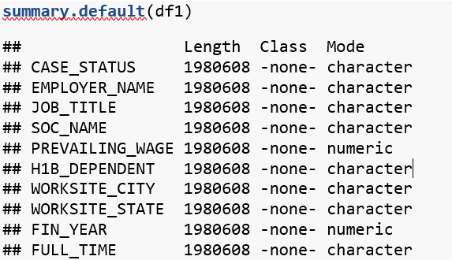
Data Summary
The H-1B dataset has 10 variables

Slide 13
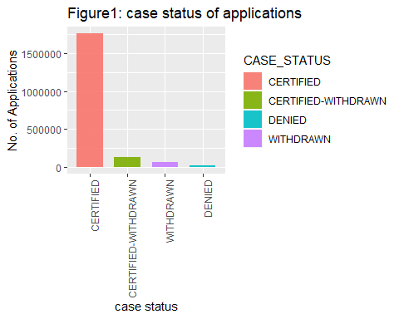
Data Visualization

Slide 14
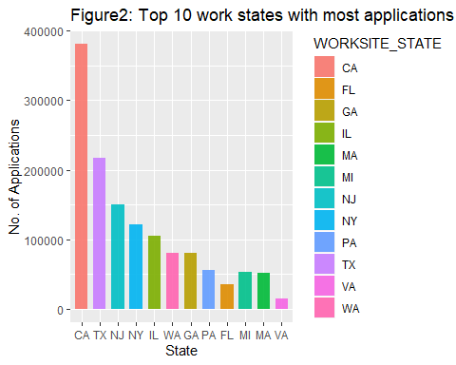

Slide 15
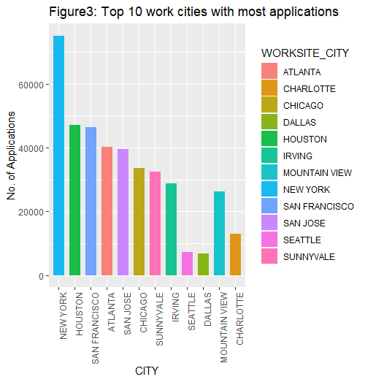

Slide 16
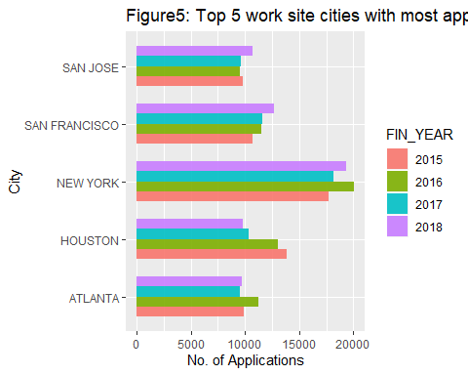

Slide 17
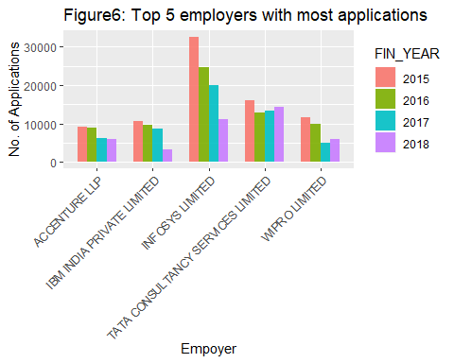

Slide 18
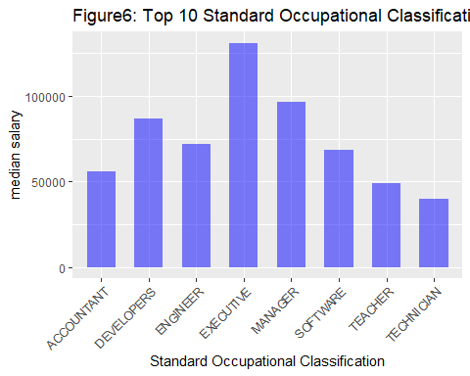

Slide 19
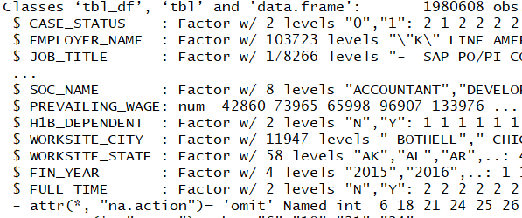
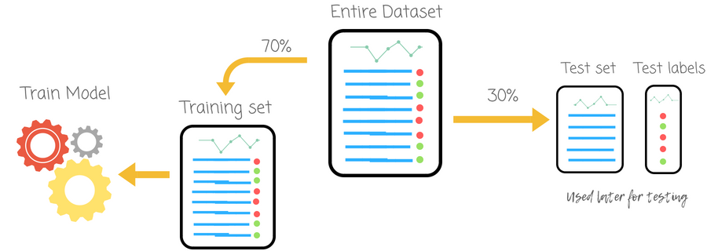
Preparing data before applying Models
Factorizing data to convert string to factors.
Dividing the data into training and test set:
70% of random data is training data.
30% of random data is test data.

Slide 20
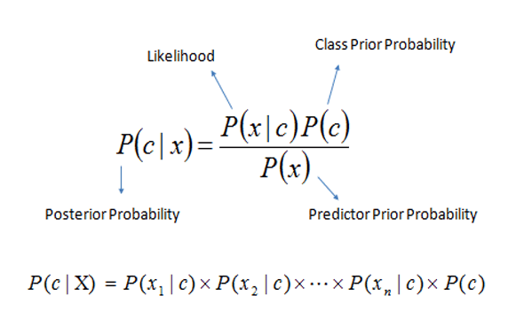
Naive Bayes classifier
In machine learning, Naive Bayes classifiers are a family of simple "probabilistic classifier" based on applying Bayes’ Theorem with strong (naive) independence assumptions between the features

Slide 21
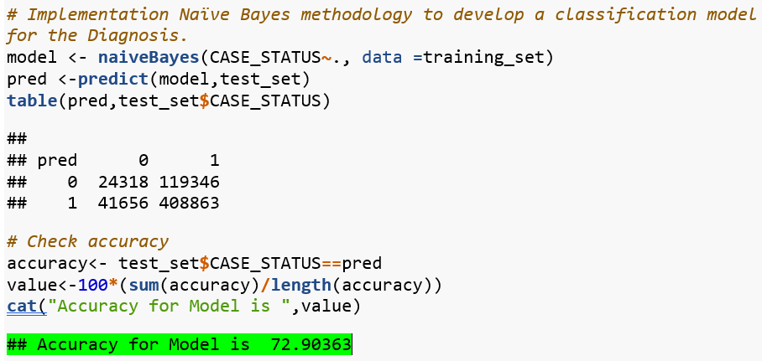

Slide 22
CART
Classification and regression trees (CART) are a non-parametric decision tree learning technique that produces either classification or regression trees, depending on whether the dependent variable is categorical or numeric, respectively.
In our case target variable that is CASE_STATUS is categorial.
Cart is binary tree from algorithms and data structures, nothing too fancy.
Each root node represents a single input variable (x) and a split point on that variable
The leaf nodes of the tree contain an output variable (y) which is used to make a prediction

Slide 23
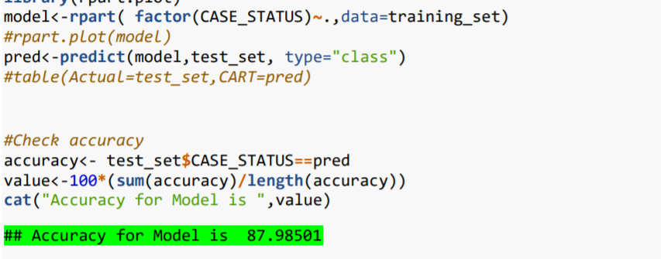

Slide 24
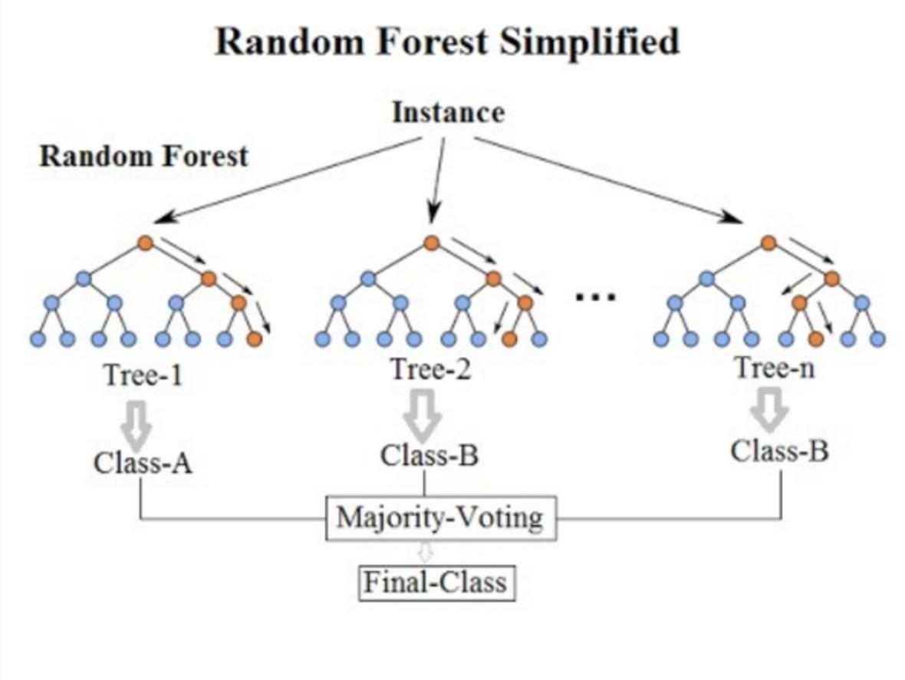
Random Forest
Random forest, like its name implies, consists of a large number of individual decision trees that operate as an ensemble. Each individual tree in the random forest spits out a class prediction and the class with the most votes becomes our model’s prediction

Slide 25
Why Random Forest Algorithm?
Random forest classifier will handle the missing values.
When we have more trees in the forest, random forest classifier won’t overfit the model.
Can model the random forest classifier for categorical values also.
Random Forests are also very hard to beat in terms of performance.
The same random forest algorithm or the random forest classifier can use for both classification and the regression task.

Slide 26
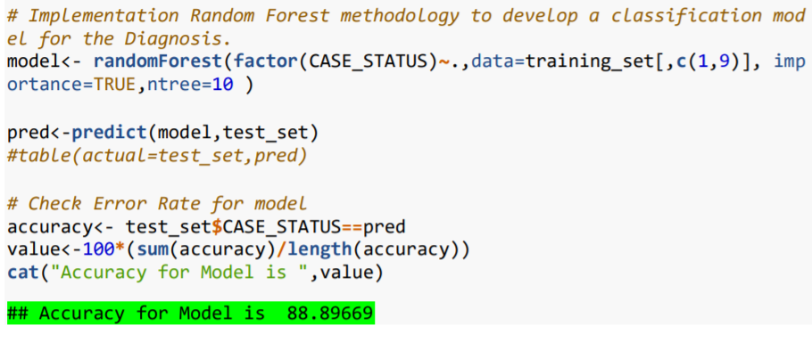

Slide 27

Conclusion
Data cleaning was the maximum time consuming process(Consumed almost 70% of the project time).

Slide 28
Conclusion
Model | Accuracy
Naïve Bayes | 72.90363
CART | 87.98501
Random forests | 88.89669
Random Forest Classification algorithm best predicts the results with an
accuracy of 88.90% for the data.

Slide 29
Thank you!

